Slide 1
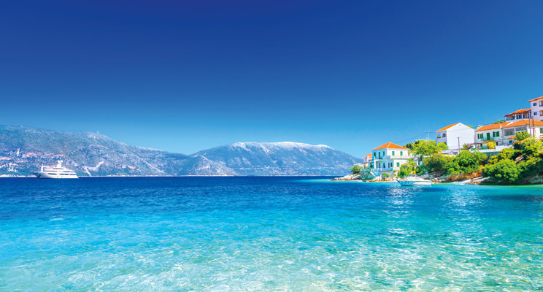
Have your hotel stand out
What is trending in the Greek Island hotel market
Using TripAdvisor data

Slide 2

1
2
3
4
Contents
Desired outcome
Most Important Features
Our Model & Metrics
What you get

Slide 3
Our Data
Web Scraping from TripAdvisor
More than 150 features
More than 3500 useful properties with over 10 reviews each
Sample Islands
Crete
Santorini
Milos
Serifos
Andros
Naxos
Paros

Slide 4

Desired Outcome

Slide 5
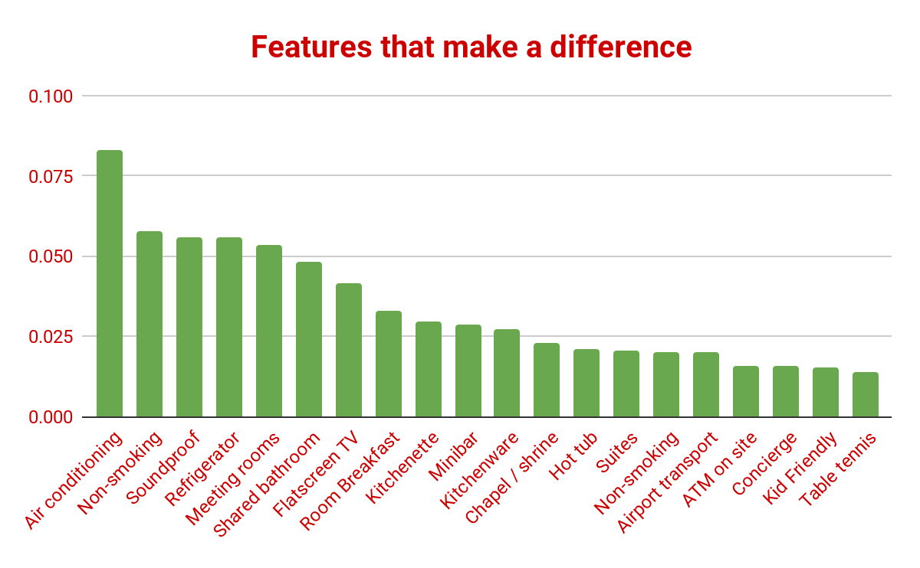

Slide 6
Our Model
94%
89%
96%
85%
100%
Random Forest Classifier
Macro F1
Recall
Accuracy
Precision
Recall for True

Slide 7
More insights
Predicted <4.5 | Predicted >4.5
14% | 6%
0% | 80%
Actual <4.5
Actual >4.5

Slide 8
What you get
Give us at least 20 features
Adapt your property
Improve Customer Satisfaction
More bookings
minimum

Slide 9

Thank you

